Slide 1
CMP203 Graphics Programming
Lighting Part 2
Materials

Slide 2
This week
Materials
Specular Lighting
Light Attenuation

Slide 3
Materials
“Material” refers to the properties of an object
And defines how that object interacts with light
Another graphics programming trick
To help with a system designed for speed of calculation rather than perfect realism
An object’s material properties determine how it reflects light and therefore what material the object seems to be made of

Slide 4
Materials
The interaction between light and materials is complex
To achieve the desired appearance is more an art form
Materials have properties for
Ambient
Diffuse
specular colours
and how shiny the surface is

Slide 5
Materials
Diffuse and ambient materials affect the colours of light reflected by an object
This determines what colour you perceive an object to be
Not light reflected onto other objects in the scene
Diffuse plays the most important role in determining this colour
The diffuse material will interact with the light where the object is lit
Ambient materials affect the overall colour of the object and is effected by the scene ambient light

Slide 6
Materials
For real-world object diffuse and ambient material are usually the same colour
For this reason OpenGL provides a method for specifying both values simultaneously

Slide 7
Controlling materials
Two functions for setting material properties
glMaterialfv
glMateriali
We will mostly be using glMaterialfv as it handles floats
glMaterialfv takes three parameters
The face of a polygon that command applies
GL_FRONT
GL_BACK
GL_FRONT_AND_BACK
Ideally you should only need GL_FRONT assuming you have drawn your shape the correctly

Slide 8
Controlling materials
The 2nd parameter is the property you want to control
Shininess
Diffuse
Ambient
Ambient and diffuse
Specular
Emission
The 3rd parameter is the value to set
A 4 float array RGBA
For now alpha should be set to 1.0

Slide 9
Materials
When changing the colour property of a material for an object
Such as ambient, diffuse or specular
What we are really dealing with is reflectivity
The colour value defines the proportion of light hitting that surface that is reflected by that surface
We can define how much Red, Green and Blue a surface reflects
These colour components are generally between 0 and 1
But they are not clamped

Slide 10
Materials
Be careful
You can specify negatives values or values above 1
For example you could set the red component to 1.5
This would mean the surface reflection is 50% more red light than what hits it
Physically impossible, but possible here as we aren’t limited by such small laws
The most common use of materials is to show specular lighting and colour geometry

Slide 11
Specular light
Specular light comes from a particular direction and bounces off the surface in a set direction
For example a laser beam bouncing off a high-quality mirror produces a near 100% specular reflection
Objects like shiny metal or plastic have a high specular component
Whereas chalk or carpet have almost none
You can think of specularity as shininess
With materials we can control the shininess of objects

Slide 12
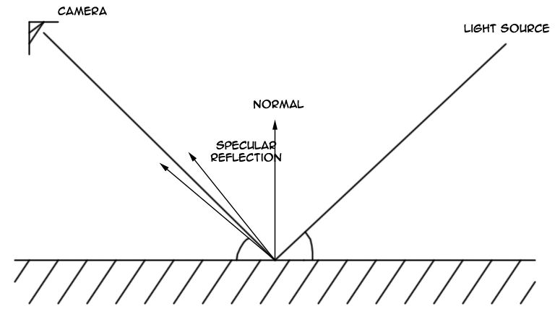
Specular light
Specular Component:
Calculated using Light, Normal, and Camera position

Slide 13

Defaults
The default material has ambient colour (0.2,0.2,0.2,1)
A diffuse colour (0.8,0.8,0.8,1)
Specular and emission colour are both black (0,0,0,1)
It's not surprising that materials, by default, do not emit extra colour
BUT by default materials have no specular reflection
This makes little sense
This means that the objects that you have seen in all our examples so far exhibit ambient and diffuse colour only
with no specular highlights

Slide 14
Specular and shiny
This image shows eight spheres the only difference between each sphere is the value of the GL_SHININESS material property
The ambient and diffuse material colours are set to (0.75,0.75,0,1), for a general yellow appearance
The specular colour is (0.75,0.75,0.75,1) white
The very left sphere the shininess is 0
which leads to an ugly specular "highlight" that covers an entire hemisphere
Going from left to right, the shininess increases by 16 from one sphere to the next

Slide 15
Colours activate
glEnable(GL_LIGHTING);
Without it ALL lighting calculations are ignored
Everything is bright and colourful
But lighting is important to get everything looking good
glEnable(GL_COLOR_MATERIAL)
Without it all glColor3f() changes are ignored when lighting is enabled
Enables a combination of lighting calculation and colour
Also adds in material calculations using default values unless otherwise specified

Slide 16
Attenuation
In the real world the intensity of light decreases as the distance from the light source increases
This is attenuation
Currently our lights don’t mimic this ability
Our lights would continue through space forever and ever
This is good when setting things up
Due to directional lights being positioned infinitely far away you can’t calculate light attenuation so it is disabled
However, for point (and spot) lights we can add light attenuation
Mimicking the real world, by having the light intensity be less when interacting with an object further away from the source

Slide 17
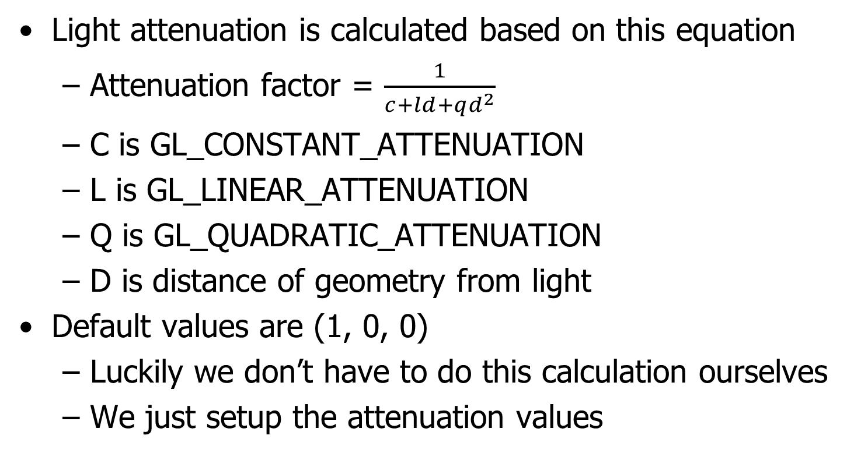
Attenuation

Slide 18
Attenuation setup
In addition to other light setup we include this
glLightf(GL_LIGHT0, GL_CONSTANT_ATTENUATION, 1.0);
glLightf(GL_LIGHT0, GL_LINEAR_ATTENUATION, 0.25);
glLightf(GL_LIGHT0, GL_QUADRATIC_ATTENUATION, 0.15);
This will create a light with a quick fall off
Meaning objects only a short distance away will receive little or no light from this source

Slide 19
Some examples
Examples of
Different materials
Specular lighting
Attenuation

Slide 20
Material example
Four objects
Diffuse material only
No ambient or specular
Diffuse and specular material/reflection + low shininess
No ambient
Shininess of 50
Diffuse and specular material/reflection + high shininess
No ambient
Shininess set to 100
Diffuse and emission materials
Emission set to a low red
No ambient or specular
Direction light positive on the x-axis

Slide 21
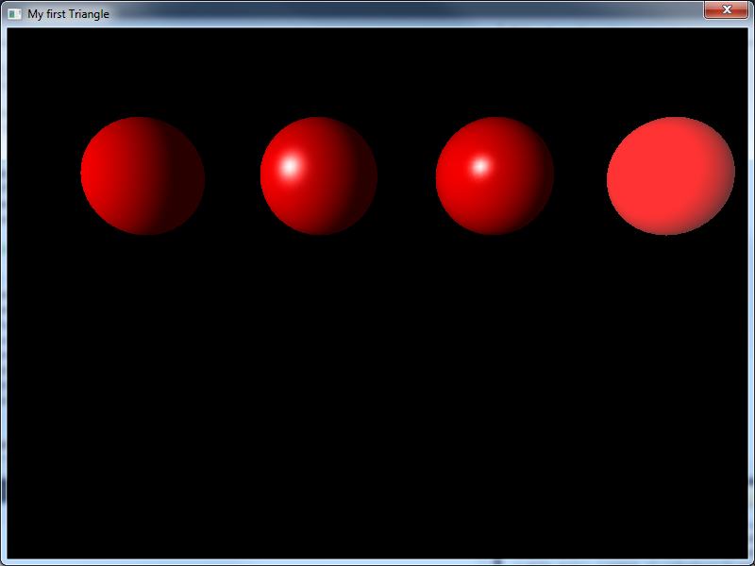
Results

Slide 22
Code
Setup a bunch of variables, making changes and re-using values made easy
GLfloat no_mat[] = {0.0, 0.0, 0.0, 0.0};
GLfloat mat_ambient[] = {0.7, 0.7, 0.7, 1.0};
GLfloat mat_ambient_colour[] = {0.8, 0.8, 0.2, 1.0};
GLfloat mat_diffuse[] = {0.1, 0.5, 0.8, 1.0};
GLfloat mat_specular[] = {1.0, 1.0, 1.0, 1.0};
GLfloat no_shininess[] = {0.0};
GLfloat low_shininess[] = {50};
GLfloat high_shininess[] = {100};
GLfloat mat_emission[] = {0.3, 0.2, 0.2, 0.0};

Slide 23
Sphere 1
glPushMatrix();
glTranslatef(-4.0, 2.0, 0.0);
glMaterialfv(GL_FRONT, GL_AMBIENT, no_mat);
glMaterialfv(GL_FRONT, GL_DIFFUSE, mat_diffuse);
glMaterialfv(GL_FRONT, GL_SPECULAR, no_mat);
glMaterialfv(GL_FRONT, GL_SHININESS, no_shininess);
glMaterialfv(GL_FRONT, GL_EMISSION, no_mat);
gluSphere(gluNewQuadric(), 1.0, 40,40);
glPopMatrix();
Similar code for other spheres
Re-positioned and change out some variables

Slide 24
Specular component
Specular setup
Add specular value to light setup
Add specular and shininess to material of object
Set shape colour and draw shape
Works best with spheres
Move the light to show the specular component at work

Slide 25
My specular setup
GLfloat Light_Ambient[] = {0.4f, 0.4f, 0.4f, 1.0f};
GLfloat Light_Diffuse[] = {1.0f, 1.0f, 1.0f, 1.0f};
GLfloat Light_Specular[] = {1.0, 1.0, 1.0, 1.0};
GLfloat Light_Position[]= {-3.0f, 0.0f, 3.0f, 1.0f};
GLfloat shininess[] = {100.0};
GLfloat highSpec[] = {1.0, 1.0, 1.0, 1.0};
glLightfv(GL_LIGHT0, GL_AMBIENT, Light_Ambient);
glLightfv(GL_LIGHT0, GL_DIFFUSE, Light_Diffuse);
glLightfv(GL_LIGHT0, GL_POSITION, Light_Position);
glLightfv(GL_LIGHT0, GL_SPECULAR, Light_Specular);
glEnable(GL_LIGHT0);
glMaterialfv(GL_FRONT, GL_SPECULAR, highSpec);
glMaterialfv(GL_FRONT, GL_SHININESS, shininess);
glColor3f(0.8, 0.0, 0.0);
gluSphere(gluNewQuadric(), 1.0, 40,40);

Slide 26
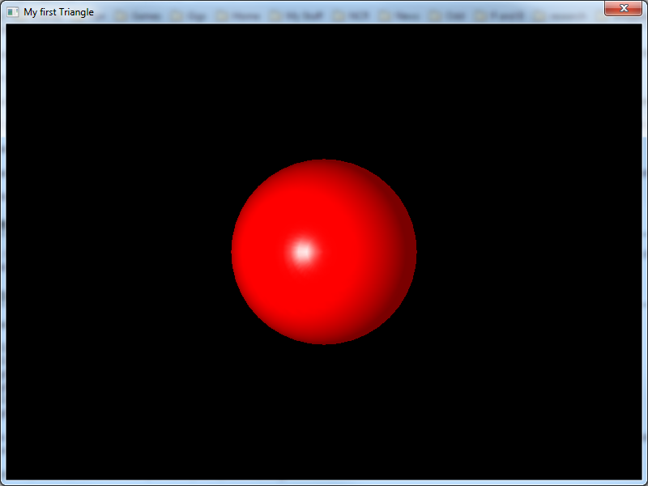
My Specular example

Slide 27
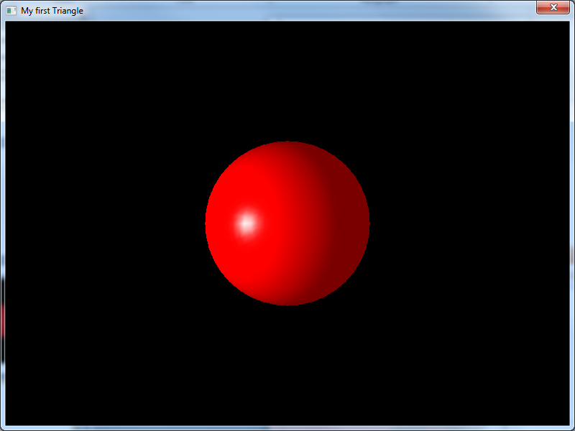
Move light

Slide 28
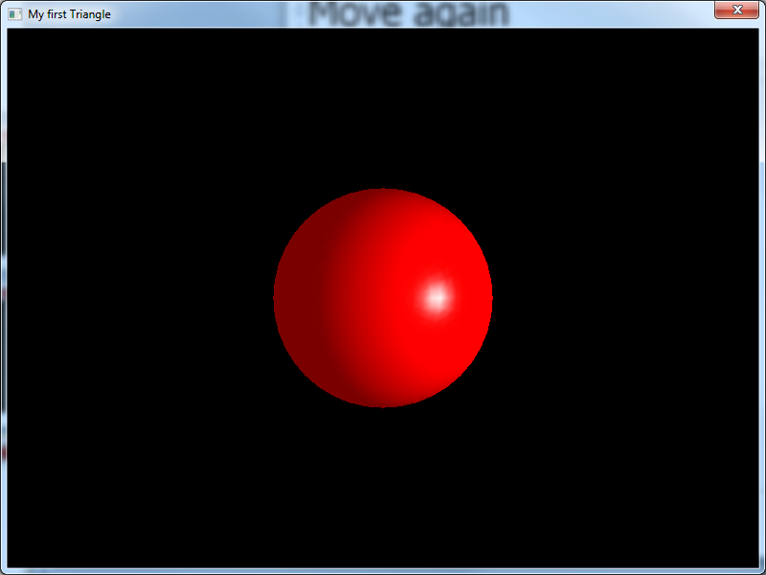
Move again

Slide 29
Light setup
For light attenuation
Need to specify the attenuation factor for our light
glLightf(GL_LIGHT0, GL_CONSTANT_ATTENUATION, 1.0);
glLightf(GL_LIGHT0, GL_LINEAR_ATTENUATION, 0.2);
glLightf(GL_LIGHT0, GL_QUADRATIC_ATTENUATION, 0.0);
Next draw three spheres, each the same size
But at different distances in the z-axis

Slide 30
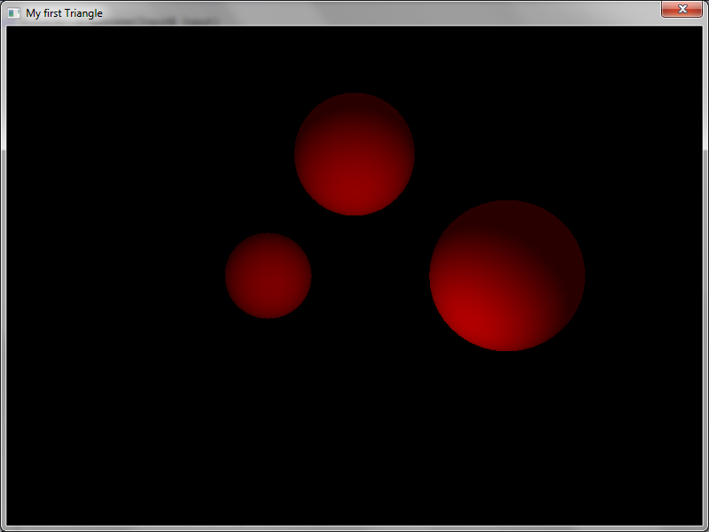

Slide 31
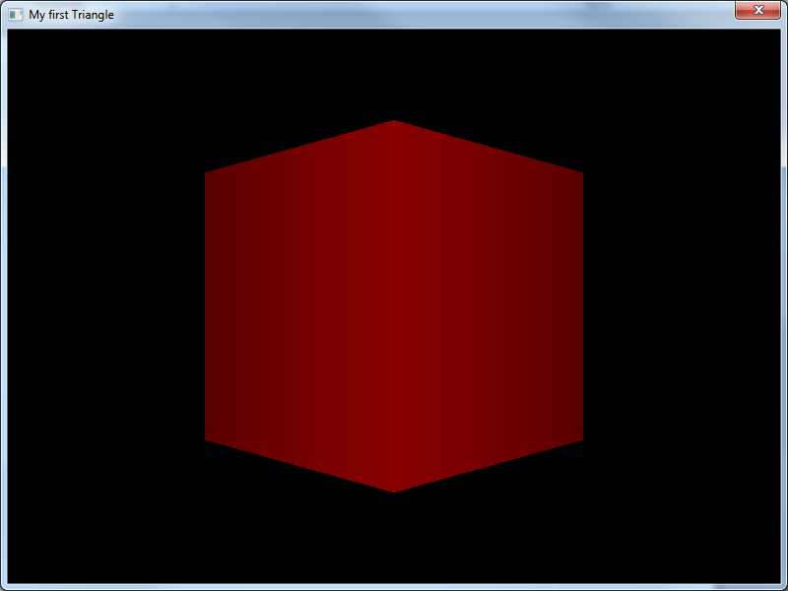

Slide 32
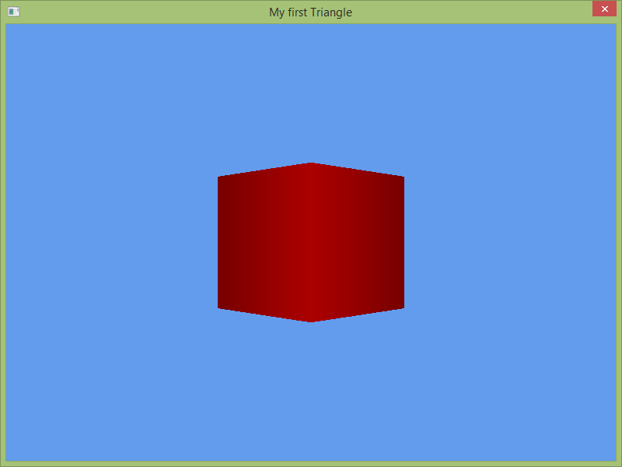

Slide 33
In the labs
Investigating light attenuation
Synthesising materials
Adding keyboard controls
Note
Work experience
Coursework

